Slide 1
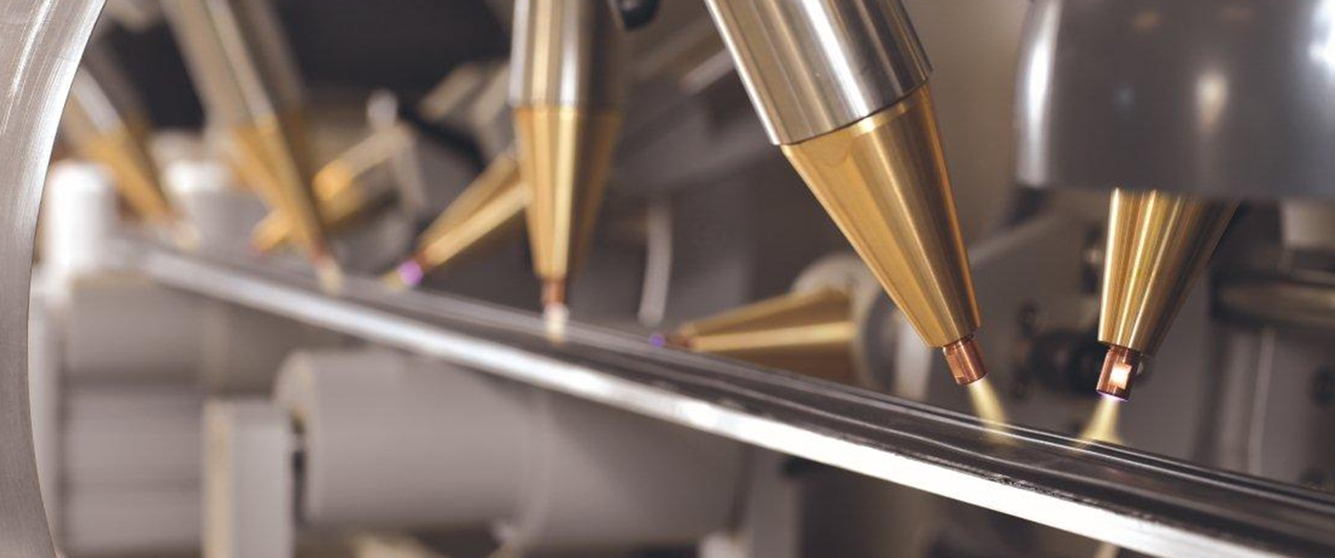


COMPETITIVE INTELLIGENCE STUDY
A GLOBAL COMPANY OPERATING IN SURFACE TREATMENT
Prepared For :
July 30, 2021
TSR/2020/268
www.techsciresearch.com
Market Intelligence . Consulting

Slide 2
REPORT CONTENT
Sl. No.
Report Content
Page No.
I
RESEARCH METHODOLOGY
4
II
EXECUTIVE SUMMARY
6-10
III
PRODUCT OVERVIEW
12-15
IV
GLOBAL MARKET OUTLOOK
17-19
V
HEF GROUP BUSINESS OVERVIEW
21-33
VI
HEF GROUP – NITRIDING BUSINESS
34-45
VII
HEF GROUP – VACUUM DEPOSITION (PVD/PAVCD) BUSINESS
46-54
VIII
HEF GROUP – SALT BATH FOR HEAT TREATMENT BUSINESS
55-61
IX
HEF GROUP – BUSHINGS/JOINTS BUSINESS
62-68
X
HEF Group – Bath Salt For Heat Treatment Business
69-84
XI
Conclusions
85-90

Slide 3

Research Methodology

Slide 4









Research Methodology
The recommended methodology for this study was based on exhaustive Secondary Research followed by extensive Primary Research. TechSci Research deployed a dedicated team who worked dedicatedly for the Client to meet research objectives.
Phase-I: Secondary Search
The team conducted exhaustive secondary research to collect the information on required set of data /information.
Phase-II: Formulating Questionnaire & Developing List of Respondents
Post Secondary Search, TechSci prepared a list of target individuals in target group and related companies across different functions and levels in different geographies. In-addition, TechSci also identified individuals in competitors and customers
TechSci team formulated guidelines to ask specific questions related with the project objectives.
Phase-III: Extensive Primary Search
TechSci Research executed primary surveys targeting identified individuals in these target companies including their competitors and customers through Telephonic methodology. TechSci Research performed periodical checks on data collected through telephonic surveys with logic checks and analyze survey results.
Phase IV:
TechSci delivered the final comprehensive project report in detailed PDF format.
Target Audience Identification
Questionnaire Design and Finalization
Survey Execution
Data Cleaning and Validation
Survey Analysis
Reporting

Slide 5

Executive Summary

Slide 6
Executive Summary
Region/Country | Nitriding |  | Vacuum Deposition |  | Salt Bath for Heat Treatment |  | Bushings/Joints |  | Nitriding Bath Salts For Heat Treatment |  | Other Bath Salts For Heat Treatment
 | Market Size | Market Share | Market Size | Market Share | Market Size | Market Share | Market Size | Market Share | Market Size | Market Share | Market Size | Market Share
North America | XXX | XXX | XXX | XXX | XXX | XXX | XXX | XXX | XXX | XXX | XXX | XXX
Asia | XXX | XXX | XXX | XXX | XXX | XXX | XXX | XXX | XXX | XXX | XXX | XXX
Europe | XXX | XXX | XXX | XXX | XXX | XXX | XXX | XXX | XXX | XXX | XXX | XXX
Asia – China - India | XXX | XXX | XXX | XXX | XXX | XXX | XXX | XXX | XXX | XXX | XXX | XXX
South America | XXX | XXX | XXX | XXX | XXX | XXX | XXX | XXX | XXX | XXX | XXX | XXX
China | XXX | XXX | XXX | XXX | XXX | XXX | XXX | XXX | XXX | XXX | XXX | XXX
India | XXX | XXX | XXX | XXX | XXX | XXX | XXX | XXX | XXX | XXX | XXX | XXX
Others | XXX | XXX | XXX | XXX | XXX | XXX | XXX | XXX | XXX | XXX | XXX | XXX
Within Asia except India and China region, Japan, Malaysia, South Korea and Thailand are key countries are having relativity higher demand
Source: Primary Interviews, TechSci Research Estimates

Slide 7
Executive Summary
Global Market - HEF Group
Treatments/Salts | 2020 |  | 2025F
 | Market Share (%) | Sales (USD Million) | Market Share (%) | Sales (USD Million)
Nitriding | XXX | XXX | XXX | XXX
Salt Bath For Heat Treatment | XXX | XXX | XXX | XXX
Vacuum Deposition | XXX | XXX | XXX | XXX
Bushings/Joints | XXX | XXX | XXX | XXX
Total Sales – HEF Group | XXX | 370.6 | XXX | 566.2
Bath Salts For Heat Treatment – Total | XXX | XXX | XXX | XXX
Nitriding Bath Salts For Heat Treatment | XXX | XXX | XXX | XXX
Other Bath Salts For Heat Treatment | XXX | XXX | XXX | XXX
Total Sales – HEF Group (including salt sales) | XXX | 370.6 | XXX | 566.2
Source: Primary Interviews, TechSci Research Estimates
Nitriding Market Share - HEF Group
Nitriding Treatments Type | 2020 |  | 2025F
 | Market Share (%) | Sales (USD Million) | Market Share (%) | Sales (USD Million)
Salt Bath Nitriding | XXX | XXX | XXX | XXX
Gas Nitriding | XXX | XXX | XXX | XXX
Plasma Nitriding | XXX | XXX | XXX | XXX
Total Nitriding | XXX | 154.7 | XXX | 242.9
Note:XXX
Figures may not add up due to rounding off.
When summing up regional market, please do not add Asia except India & China, China, and India, as these are segmentation of Asia-Total.
Source: Primary Interviews, TechSci Research Estimates

Slide 8
Executive Summary
Regional Market Share - HEF Group, 2020
Treatments/Salts | North America | Asia | Europe | Asia – China -India | South America | China | India | Others
Nitriding | XXX | XXX | XXX | XXX | XXX | XXX | XXX | XXX
Salt Bath For Heat Treatment | XXX | XXX | XXX | XXX | XXX | XXX | XXX | XXX
Vacuum Deposition | XXX | XXX | XXX | XXX | XXX | XXX | XXX | XXX
Bushings/Joints | XXX | XXX | XXX | XXX | XXX | XXX | XXX | XXX
Nitriding Bath Salts For Heat Treatment | XXX | XXX | XXX | XXX | XXX | XXX | XXX | XXX
Other Bath Salts For Heat Treatment | XXX | XXX | XXX | XXX | XXX | XXX | XXX | XXX
Source: Primary Interviews, TechSci Research Estimates
Regional Market Size - HEF Group, 2020
Treatments/Salts | North America | Asia | Europe | Asia – China -India | South America | China | India | Others
Nitriding | XXX | XXX | XXX | XXX | XXX | XXX | XXX | XXX
Salt Bath For Heat Treatment | XXX | XXX | XXX | XXX | XXX | XXX | XXX | XXX
Vacuum Deposition | XXX | XXX | XXX | XXX | XXX | XXX | XXX | XXX
Bushings/Joints | XXX | XXX | XXX | XXX | XXX | XXX | XXX | XXX
Nitriding Bath Salts For Heat Treatment | XXX | XXX | XXX | XXX | XXX | XXX | XXX | XXX
Other Bath Salts For Heat Treatment | XXX | XXX | XXX | XXX | XXX | XXX | XXX | XXX
Within Asia except India and China region, Japan, Malaysia, South Korea and Thailand are key countries are having relativity higher demand
Source: Primary Interviews, TechSci Research Estimates

Slide 9
Executive Summary
Regional Market Share - HEF Group, 2025
Treatments/Salts | North America | Asia | Europe | Asia – China -India | South America | China | India | Others
Nitriding | XXX | XXX | XXX | XXX | XXX | XXX | XXX | XXX
Salt Bath For Heat Treatment | XXX | XXX | XXX | XXX | XXX | XXX | XXX | XXX
Vacuum Deposition | XXX | XXX | XXX | XXX | XXX | XXX | XXX | XXX
Bushings/Joints | XXX | XXX | XXX | XXX | XXX | XXX | XXX | XXX
Nitriding Bath Salts For Heat Treatment | XXX | XXX | XXX | XXX | XXX | XXX | XXX | XXX
Other Bath Salts For Heat Treatment | XXX | XXX | XXX | XXX | XXX | XXX | XXX | XXX
Source: Primary Interviews, TechSci Research Estimates
Regional Market Size - HEF Group, 2025
Treatments/Salts | North America | Asia | Europe | Asia – China -India | South America | China | India | Others
Nitriding | XXX | XXX | XXX | XXX | XXX | XXX | XXX | XXX
Salt Bath For Heat Treatment | XXX | XXX | XXX | XXX | XXX | XXX | XXX | XXX
Vacuum Deposition | XXX | XXX | XXX | XXX | XXX | XXX | XXX | XXX
Bushings/Joints | XXX | XXX | XXX | XXX | XXX | XXX | XXX | XXX
Nitriding Bath Salts For Heat Treatment | XXX | XXX | XXX | XXX | XXX | XXX | XXX | XXX
Other Bath Salts For Heat Treatment | XXX | XXX | XXX | XXX | XXX | XXX | XXX | XXX
Within Asia except India and China region, Japan, Malaysia, South Korea and Thailand are key countries are having relativity higher demand
Source: Primary Interviews, TechSci Research Estimates

Slide 10
Executive Summary
Treatments | Treatments
 | Nitriding | Salt Bath For Heat Treatment | Vacuum Deposition | Bushings/Joints | Bath Salts For Heat Treatment
Key Customers | XXX | XXX | XXX | XXX | XXX
 | XXX | XXX | XXX | XXX | XXX
 | XXX | XXX | XXX | XXX | XXX
 | XXX | XXX | XXX | XXX | XXX
 | XXX | XXX | XXX | XXX | XXX
Source: Primary Interviews, TechSci Research Estimates
TechSci has conducted several interviews where respondents have confirmed that these are the primary customers in each segment. There have been cases where HEF puts up furnaces and other equipment at the company’s premises and looks after the entire process and maintenance.

Slide 11
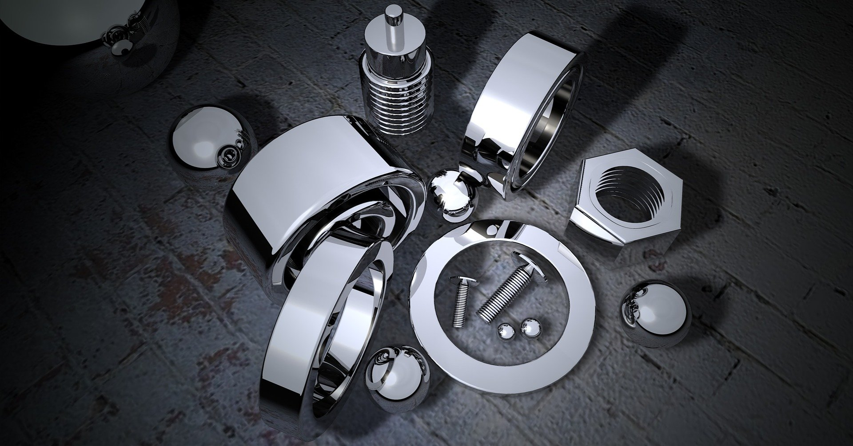
Product Overview

Slide 12
Product Overview
NITRIDING:
XXX
XXX
XXX
XXX
XXX
XXX
XXX
XXX
XXX
XXX
XXX
XXX

Slide 13
Product Overview
VACUUM DEPOSITION (PVD & PACVD):
XXX
XXX
XXX
XXX
XXX
XXX
XXX
XXX
XXX
XXX
XXX
XXX
XXX

Slide 14
Product Overview
SALT BATH FOR HEAT TREATMENT:
XXX
XXX
XXX
XXX
XXX
XXX
XXX
BUSHINGS/JOINTS:
XXX
XXX
XXX
XXX

Slide 15
Product Overview
BATH SALT FOR HEAT TREATMENT:
XXX
XXX
XXX
XXX
XXX
XXX
XXX
XXX
XXX
XXX
XXX
XXX
XXX

Slide 16
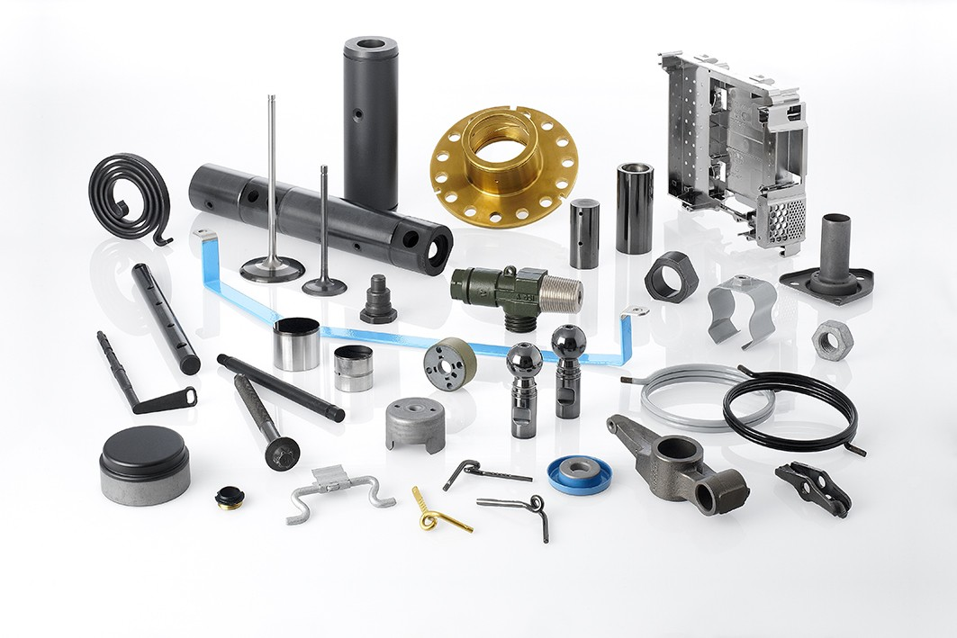
Global Market Outlook

Slide 17
Global Market, Million USD, 2020
XXX
XXX
XXX
XXX
XXX
XXX
XXX
XXX
XXX
XXX
XXX
Source: Primary Interviews, TechSci Research Estimates
Source: Primary Interviews, TechSci Research Estimates
Source: Primary Interviews, TechSci Research Estimates
Within Asia except India and China region, Japan, Malaysia, South Korea and Thailand are key countries are having relativity higher demand

Slide 18
Regional Market, Million USD, 2020
Source: Primary Interviews, TechSci Research Estimates
Source: Primary Interviews, TechSci Research Estimates
Source: Primary Interviews, TechSci Research Estimates
Source: Primary Interviews, TechSci Research Estimates
Within Asia except India and China region, Japan, Malaysia, South Korea and Thailand are key countries are having relativity higher demand

Slide 19
List Of Companies Operating In Nitriding Business
List Of Companies Operating In Nitriding Business
Company | Headquarters Location | Equipment/Treatment
XXX | XXX | XXX
XXX | XXX | XXX
XXX | XXX | XXX
XXX | XXX | XXX
XXX | XXX | XXX
XXX | XXX | XXX
XXX | XXX | XXX
XXX | XXX | XXX
XXX | XXX | XXX
XXX | XXX | XXX
XXX | XXX | XXX
XXX | XXX | XXX
XXX | XXX | XXX
XXX | XXX | XXX
XXX | XXX | XXX
Source: Primary Interviews, TechSci Research Estimates

Slide 20
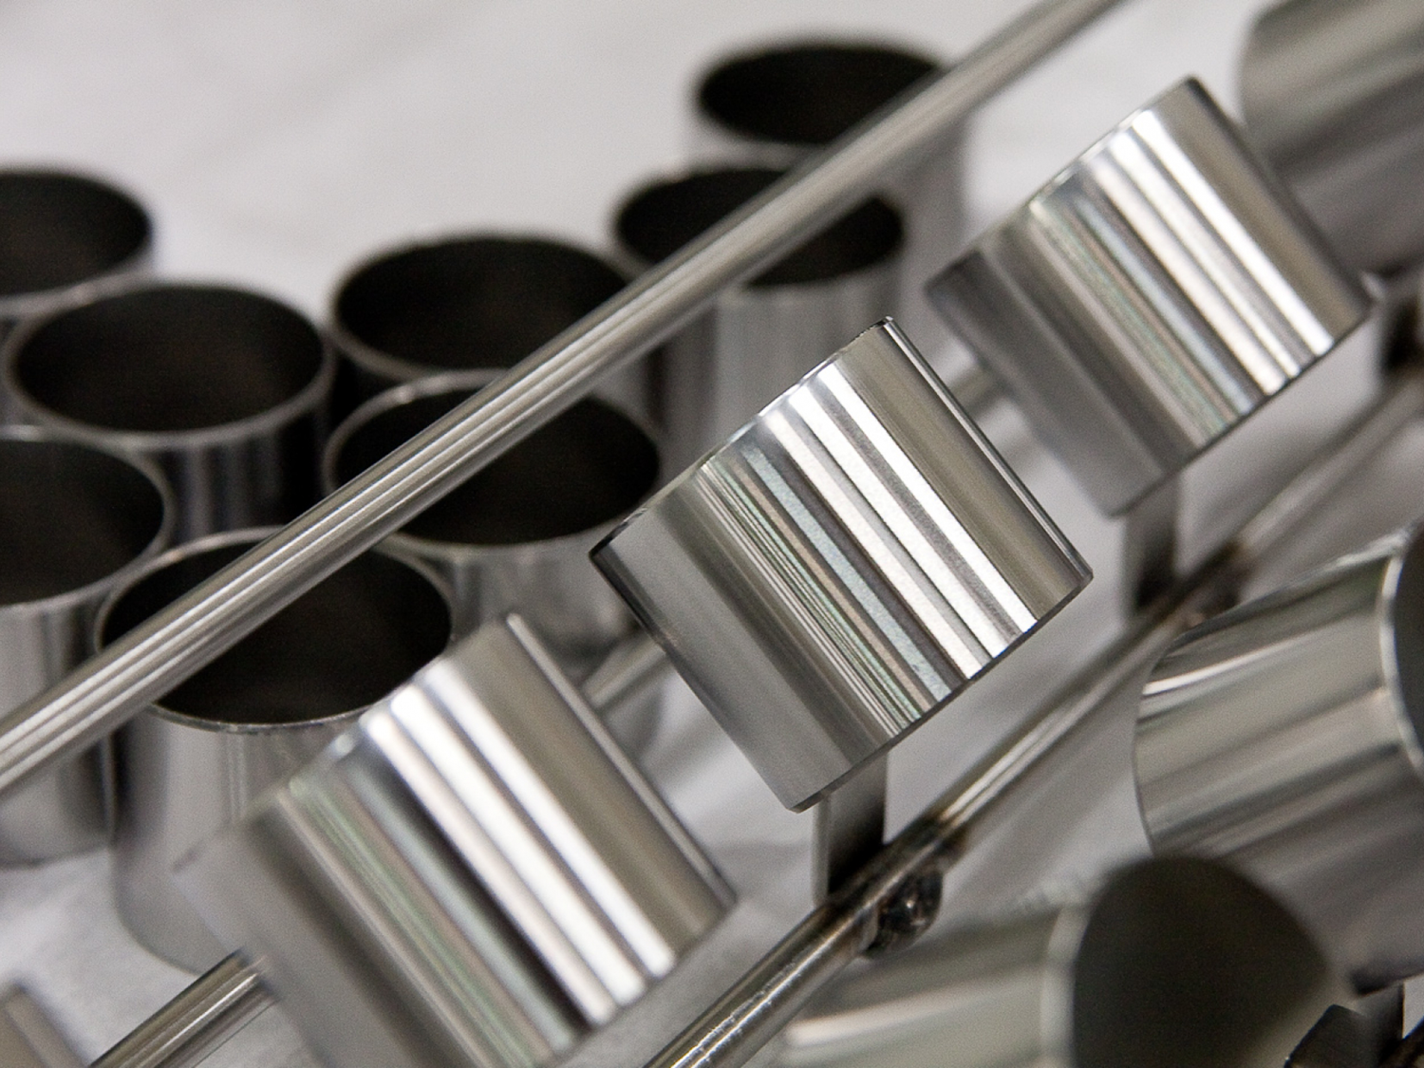
HEF GROUP BUSINESS OVERVIEW

Slide 21
HEF Group Business Overview
XXX.
XXX:
XXXX
XXXX
XXXX
XXXX
XXX.
XXX.
XXX.
XXX.
XXX.
XXX.
XXX.
XXX.
XXX.
XXX.
HEF Capital Holdings
XXX
XXX
XXX
Source: HEF Groupe Company Website

Slide 22
HEF Group Business Overview
HEF Group- Global Presence
Company | Region | Country
XXX | XXX | XXX
 | XXX | XXX
 | XXX | XXX
 | XXX | XXX
 | XXX | XXX
XXX | XXX | XXX
 | XXX | XXX
 | XXX | XXX
 | XXX | XXX
Source: HEF Groupe Company Website

Slide 23
HEF Group Organizational Structure
HEF Groupe
XXX
XXX
XXX
XXX
XXX
XXX
XXX
XXX
XXX
XXX
XXX
XXX
XXX
XXX
XXX
XXX
XXX
XXX
Source: HEF Groupe Company Website

Slide 24
Global Market Share (%) – HEF Group
Global Market - HEF Group
Treatments/Salts | 2020 |  | 2025F
 | Market Share (%) | Sales (USD Million) | Market Share (%) | Sales (USD Million)
Nitriding | XXX | XXX | XXX | XXX
Salt Bath For Heat Treatment | XXX | XXX | XXX | XXX
Vacuum Deposition | XXX | XXX | XXX | XXX
Bushings/Joints | XXX | XXX | XXX | XXX
Total Sales – HEF Group | XXX | 370.6 | XXX | 566.2
Bath Salts For Heat Treatment – Total | XXX | XXX | XXX | XXX
Nitriding Bath Salts For Heat Treatment | XXX | XXX | XXX | XXX
Other Bath Salts For Heat Treatment | XXX | XXX | XXX | XXX
Total Sales – HEF Group (including salt sales) | XXX | 370.6 | XXX | 566.2
Source: Primary Interviews, TechSci Research Estimates
Nitriding Market Share - HEF Group
Nitriding Treatments Type | 2020 |  | 2025F
 | Market Share (%) | Sales (USD Million) | Market Share (%) | Sales (USD Million)
Salt Bath Nitriding | XXX | XXX | XXX | XXX
Gas Nitriding | XXX | XXX | XXX | XXX
Plasma Nitriding | XXX | XXX | XXX | XXX
Total Nitriding | XXX | 154.7 | XXX | 242.9
Note: HEF provides gas nitriding and plasma nitriding through subsidiaries such as TS Deutschland GmbH, HEF-DURFERRIT s.r.o., TS Zbąszynek, TS Magyarország Kft, and Northeast Coating Technologies primarily in Germany, Poland, Czech republic, Hungary , etc.,
Source: Primary Interviews, TechSci Research Estimates

Slide 25
Regional Market Share (%) – HEF Group
Regional Market Share - HEF Group, 2020
Treatments/Salts | North America | Asia | Europe | Asia – China -India | South America | China | India | Others
Nitriding | XXX | XXX | XXX | XXX | XXX | XXX | XXX | XXX
Salt Bath For Heat Treatment | XXX | XXX | XXX | XXX | XXX | XXX | XXX | XXX
Vacuum Deposition | XXX | XXX | XXX | XXX | XXX | XXX | XXX | XXX
Bushings/Joints | XXX | XXX | XXX | XXX | XXX | XXX | XXX | XXX
Nitriding Bath Salts For Heat Treatment | XXX | XXX | XXX | XXX | XXX | XXX | XXX | XXX
Other Bath Salts For Heat Treatment | XXX | XXX | XXX | XXX | XXX | XXX | XXX | XXX
Source: Primary Interviews, TechSci Research Estimates
Regional Market Share - HEF Group, 2025
Treatments/Salts | North America | Asia | Europe | Asia – China -India | South America | China | India | Others
Nitriding | XXX | XXX | XXX | XXX | XXX | XXX | XXX | XXX
Salt Bath For Heat Treatment | XXX | XXX | XXX | XXX | XXX | XXX | XXX | XXX
Vacuum Deposition | XXX | XXX | XXX | XXX | XXX | XXX | XXX | XXX
Bushings/Joints | XXX | XXX | XXX | XXX | XXX | XXX | XXX | XXX
Nitriding Bath Salts For Heat Treatment | XXX | XXX | XXX | XXX | XXX | XXX | XXX | XXX
Other Bath Salts For Heat Treatment | XXX | XXX | XXX | XXX | XXX | XXX | XXX | XXX
Within Asia except India and China region, Japan, Malaysia, South Korea and Thailand are key countries are having relativity higher demand
Source: Primary Interviews, TechSci Research Estimates

Slide 26
Regional Sales - HEF Group, Million USD, 2020
Source: Primary Interviews, TechSci Research Estimates
Source: Primary Interviews, TechSci Research Estimates
Source: Primary Interviews, TechSci Research Estimates
Source: Primary Interviews, TechSci Research Estimates
Within Asia except India and China region, Japan, Malaysia, South Korea and Thailand are key countries are having relativity higher demand

Slide 27
Regional Sales - HEF Group, Million USD, 2020
Source: Primary Interviews, TechSci Research Estimates
Source: Primary Interviews, TechSci Research Estimates
Within Asia except India and China region, Japan, Malaysia, South Korea and Thailand are key countries are having relativity higher demand

Slide 28
Regional Sales - HEF Group, Million USD , 2025
Source: Primary Interviews, TechSci Research Estimates
Source: Primary Interviews, TechSci Research Estimates
Source: Primary Interviews, TechSci Research Estimates
Source: Primary Interviews, TechSci Research Estimates
Within Asia except India and China region, Japan, Malaysia, South Korea and Thailand are key countries are having relativity higher demand

Slide 29
Regional Sales - HEF Group, Million USD, 2025
Source: Primary Interviews, TechSci Research Estimates
Source: Primary Interviews, TechSci Research Estimates
Within Asia except India and China region, Japan, Malaysia, South Korea and Thailand are key countries are having relativity higher demand

Slide 30
Bath Salts For Heat Treatment Sales - HEF Group, Million USD
Bath Salts (Share in Total Bath Salt Sales Of HEF Group - %) | 2020 |  |  | 2025
 | Captive Sales (Internal Sales) | Merchant Sales | Total Sales | Captive Sales (Internal Sales) | Merchant Sales | Total Sales
Nitriding Salts | XXX | XXX | XXX | XXX | XXX | XXX
Other Salts | XXX | XXX | XXX | XXX | XXX | XXX
Source: Primary Interviews, TechSci Research Estimates

Slide 31
Bath Salts For Heat Treatment Sales - HEF Group, Million USD, 2020
Source: Primary Interviews, TechSci Research Estimates
Source: Primary Interviews, TechSci Research Estimates
Source: Primary Interviews, TechSci Research Estimates
Source: Primary Interviews, TechSci Research Estimates
Within Asia except India and China region, Japan, Malaysia, South Korea and Thailand are key countries are having relativity higher demand

Slide 32
Bath Salts For Heat Treatment Sales - HEF Group, Million USD, 2025
Source: Primary Interviews, TechSci Research Estimates
Source: Primary Interviews, TechSci Research Estimates
Source: Primary Interviews, TechSci Research Estimates
Source: Primary Interviews, TechSci Research Estimates
Within Asia except India and China region, Japan, Malaysia, South Korea and Thailand are key countries are having relativity higher demand

Slide 33
Furnace Details
Treatments | Number Of Furnaces
Treatments | Global | North America | Asia | Europe | APAC - China - India | South America | China | India | Others
Nitriding | XXX | XXX | XXX | XXX | XXX | XXX | XXX | XXX | XXX
Vaccum Deposition | XXX | XXX | XXX | XXX | XXX | XXX | XXX | XXX | XXX
Treatments | Number Of Factories | Number Of Factories
Treatments | Global | North America | Asia | Europe | APAC - China - India | South America | China | India | Others
Nitriding | XXX | XXX | XXX | XXX | XXX | XXX | XXX | XXX | XXX
Vaccum Deposition | XXX | XXX | XXX | XXX | XXX | XXX | XXX | XXX | XXX
Within Asia except India and China region, Japan, Malaysia, South Korea and Thailand are key countries are having relativity higher demand
Source: Primary Interviews

Slide 34
HEF Group – Nitriding Business
Key Customers | Typical Order Unit Price ($/unit) Average Weight: 50 kgs | Typical Order Quantity (kg/year)
General Motors | XXX | XXX
Ford Motors | XXX | XXX
Toyota | XXX | XXX
Hyundai Motors | XXX | XXX
Tata Motors | XXX | XXX
Source: Primary Interviews
XXX
XXX
XXX
XXX
Surface Treatment Equipment Used For Nitriding
XXX
XXX
XXX
XXX
XXX
XXX
XXX
XXX
Source: Primary Interviews
Note: Most of the key customers are automotive companies and HEF Groupe claims to cater all the major players in the automotive industry globally.
Note: XXX

Slide 35
HEF Group – Nitriding Business
Technology Superiority
XXX | XXX | XXX
 | XXX | XXX
 | XXX | XXX
 | XXX | XXX
Source: Primary Interviews

Slide 36
HEF Group – Nitriding Business
Production Capacity and Factory Scale
XXX | XXX | XXX
 | XXX | XXX
 | XXX | XXX
 | XXX | XXX
 | XXX | XXX
 | XXX | XXX
 | XXX | XXX
 | XXX | XXX
Note: TechSci conducted several interview with HEF Group, the respondents mentioned that furnace type does not vary regionally or factory wise. The type of furnace to be used depends on customer requirement and size of the components being processed.
Source: Primary Interviews

Slide 37
HEF Group – Nitriding Business
HEF Groupe
XXX
XXX
XXX
XXX
XXX
XXX
XXX
XXX
XXX
XXX
XXX
Source: HEF Groupe Company Website

Slide 38
HEF Group – Nitriding Business
Evaluation From The Market
XXX
XXX
XXX
XXX
XXX
Comparison Of New ARCOR Treatment To Previous ARCOR Treatments
 | ARCOR V | ARCOR N | ARCOR DT | ARCOR L | ARCOR CS
XXX | XXX | XXX | XXX | XXX | XXX
XXX | XXX | XXX | XXX | XXX | XXX
XXX | XXX | XXX | XXX | XXX | XXX
XXX | XXX | XXX | XXX | XXX | XXX
XXX | XXX | XXX | XXX | XXX | XXX
Source: Primary Interviews, Secondary Sources, HEF Group Company Website

Slide 39
HEF Group – Nitriding Business
Evaluation From The Market Contd.
XXX
XXX
XXX
XXX
XXX
XXX
Advantages of CLIN Treatment
Advantages | Details
XXX | XXX
XXX | XXX
XXX | XXX
XXX | XXX
XXX | XXX
XXX | XXX
XXX | XXX
XXX | XXX
Source: Primary Interviews, Secondary Sources, HEF Group Company Website

Slide 40
HEF Group – Nitriding Business
Evaluation From The Market Contd.
Technical Superiority Of HEF Nitriding
XXX
XXX
XXX
XXX
XXX
XXX
XXX
XXX
XXX
XXX
XXX
XXX
XXX
XXX
XXX
XXX
XXX
Source: Primary Interviews, Secondary Sources, HEF Group Company Website

Slide 41
HEF Group – Salt Bath For Heat Treatment Business
Evaluation From The Market
XXX
XXX
XXX
XXX
XXX
XXX
XXX
XXX
XXX
XXX
XXX
XXX
XXX
XXX
XXX
XXX
XXX
XXX
XXX
XXX
Source: Primary Interviews, Secondary Sources, HEF Group Company Website

Slide 42
HEF Group – Salt Bath For Heat Treatment Business
Evaluation From The Market
XXX XXX
XXX
XXX
XXX
XXX
XXX
XXX
XXX
XXX
XXX
XXX
XXX
XXX
XXX
XXX
XXX
XXX
XXX
XXX
Source: Primary Interviews, Secondary Sources, HEF Group Company Website

Slide 43
HEF Group – Nitriding Business
Evaluation From The Market Contd.
XXX XXX
XXX
XXX
XXX
XXX
XXX
XXX
XXX
XXX
XXX
XXX
XXX
XXX
XXX
XXX
XXX
XXX
XXX
XXX
Source: Primary Interviews, Secondary Sources, HEF Group Company Website

Slide 44
HEF Group – Nitriding Business
Evaluation From The Market Contd.
XXX
XXX
XXX
XXX
Stages And Significance Of CLIN Treatment
Stages | Significance
XXX | XXX
XXX | XXX
XXX | XXX
XXX | XXX
XXX | XXX
XXX | XXX
XXX | XXX
XXX | XXX
*XXX
Source: Primary Interviews, Secondary Sources, HEF Group Company Website

Slide 45
HEF Group – Nitriding Business
Evaluation From The Market Contd.
XXX XXX
XXX
XXX
XXX
XXX
XXX
XXX
XXX
XXX
XXX
XXX
XXX
XXX
XXX
XXX
XXX
XXX
XXX
XXX
Source: Primary Interviews, Secondary Sources, HEF Group Company Website

Slide 46
HEF Group – Vacuum Deposition (PVD/PAVCD) Business
Key Customers | Typical Order Unit Price ($/unit) Average Weight: 50 kgs | Typical Order Quantity (kg/year)
XXX | XXX | XXX
XXX | XXX | XXX
XXX | XXX | XXX
XXX | XXX | XXX
XXX | XXX | XXX
Source: Primary Interviews
XXX
XXX
Surface Treatment Equipment Used For Vacuum Deposition (PVD/PAVCD)
XXX
XXX
XXX
XXX
XXX
XXX
XXX
XXX
Source: Primary Interviews
Note: Most of the key customers are automotive companies and HEF Groupe claims to cater all the major players in the automotive industry globally.
Note: The prices are may vary as they are dependent on several conditions such as furnace dimensions used, the maximum number of pieces that can be treated at one time, operational cost for a full load, the quantity or weight of a full load of treated components, etc. If less than a full load is treated, the total price based upon $/unit is compared with the minimum lot charge, and the greater of the two is applied.

Slide 47
HEF Group – Vacuum Deposition (PVD/PAVCD) Business
Technology Superiority
XXX | XXX | XXX
 | XXX | XXX
Vacuum Deposition (PVD/PAVCD) Business | XXX | XXX
 | XXX | XXX
 | XXX | XXX
 | XXX | XXX
Source: Primary Interviews

Slide 48
HEF Group – Vacuum Deposition (PVD/PAVCD) Business
Production Capacity and Factory Scale
XXX | XXX | XXX
 | XXX | XXX
Vacuum Deposition (PVD/PAVCD) Business | XXX | XXX
 | XXX | XXX
 | XXX | XXX
 | XXX | XXX
 | XXX | XXX
 | XXX | XXX
Note: TechSci conducted several interview with HEF Group, the respondents mentioned that furnace type does not vary regionally or factory wise. The type of furnace to be used depends on customer requirement and size of the components being processed.
Source: Primary Interviews

Slide 49
HEF Group – Vacuum Deposition (PVD/PAVCD) Business
HEF Groupe
XXX
XXX
XXX
XXX
XXX
Locations
XXX
XXX
XXX
XXX
Source: HEF Groupe Company Website

Slide 50
HEF Group – Vacuum Deposition (PVD/PAVCD) Business
Evaluation From The Market
XXX XXX
XXX
XXX
XXX
XXX
XXX
XXX
XXX
XXX
XXX
XXX
XXX
XXX
XXX
XXX
XXX
XXX
XXX
XXX
Source: Primary Interviews, Secondary Sources, HEF Group Company Website

Slide 51
HEF Group – Vacuum Deposition (PVD/PAVCD) Business
Evaluation From The Market Contd.
HEF’s Standard Coating Portfolio Along With Their Unique Properties
Coating | Hardness (HV) | Max. Usage Temperature (Celsius) | Coating Thickness (micron) | Deposition Temperature (Celsius) | Coef. Of Friction (dry) against steel | Typical Applications
XXX | XXX | XXX | XXX | XXX | XXX | Forming tools
 |  |  |  |  |  | XXX
 |  |  |  |  |  | XXX
XXX | XXX | XXX | XXX | XXX | XXX | XXX
XXX | XXX | XXX | XXX | XXX | XXX | XXX
 |  |  |  |  |  | XXX
 |  |  |  |  |  | XXX
XXX | XXX | XXX | XXX | XXX | XXX | XXX
XXX | XXX | XXX | XXX | XXX | XXX | XXX
 |  |  |  |  |  | XXX
XXX | XXX | XXX | XXX | XXX | XXX | XXX
XXX | XXX | XXX | XXX | XXX | XXX | XXX
XXX | XXX | XXX | XXX | XXX | XXX | XXX
Source: Primary Interviews, Secondary Sources, HEF Group Company Website

Slide 52
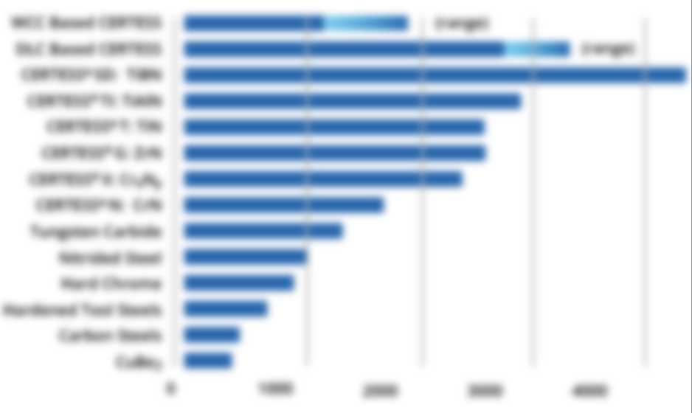
HEF Group – Vacuum Deposition (PVD/PAVCD) Business
Evaluation From The Market Contd.
XXX
XXX
XXX
XXX
HEF Product Offering For Various Applications
Comparison Of HEF Coating Hardness (HV)
Applications | HEF’s Product Group
XXX | XXX
XXX | XXX
XXX | XXX
XXX | XXX
XXX | XXX
Source: Primary Interviews, Secondary Sources, HEF Group Company Website

Slide 53
HEF Group – Vacuum Deposition (PVD/PAVCD) Business
Evaluation From The Market Contd.
XXX XXX
XXX
XXX
XXX
XXX
XXX
XXX
XXX
XXX
XXX
XXX
XXX
XXX
XXX
XXX
XXX
XXX
XXX
XXX
Source: Primary Interviews, Secondary Sources, HEF Group Company Website

Slide 54
HEF Group – Vacuum Deposition (PVD/PAVCD) Business
Evaluation From The Market Contd.
Common commercial variants of WCC and DLC coatings from HEF
Properties | XXX
XXX | XXX | XXX | XXX | XXX | XXX | XXX
XXX | XXX | XXX | XXX | XXX | XXX | XXX
XXX | XXX | XXX | XXX | XXX | XXX | XXX
XXX | XXX | XXX | XXX | XXX | XXX | XXX
XXX | XXX | XXX | XXX | XXX | XXX | XXX
XXX | XXX | XXX | XXX | XXX | XXX | XXX
XXX | XXX | XXX | XXX | XXX | XXX | XXX
XXX | XXX | XXX | XXX | XXX | XXX | XXX
Source: Primary Interviews, Secondary Sources, HEF Group Company Website

Slide 55
HEF Group – Salt Bath For Heat Treatment Business
Key Customers | Typical Order Unit Price ($/unit) Average Weight: 50 kgs | Typical Order Quantity (kg/year)
XXX | XXX | XXX
XXX | XXX | XXX
XXX | XXX | XXX
XXX | XXX | XXX
XXX | XXX | XXX
Source: Primary Interviews
XXX
XXX
XXX
XXX
Production Capacity and Factory Scale
XXX | XXX | XXX
 | XXX | XXX
 | XXX | XXX
 | XXX | XXX
Source: Primary Interviews
Note: XXX

Slide 56
HEF Group – Salt Bath For Heat Treatment Business
Technology Superiority
XXX | XXX | XXX
 | XXX | XXX
 | XXX | XXX
 | XXX | XXX
Source: Primary Interviews
Surface Treatment Equipment Used For Salt Bath For Heat Treatment
XXX
XXXX
XXX
XXX
XXX
XXX
XXX
XXX
Source: Primary Interviews

Slide 57
HEF Group – Salt Bath For Heat Treatment Business
HEF Groupe
XXX
XXX
XXX
XXX
XXX
Locations
XXX
XXX
XXX
XXX
Source: HEF Groupe Company Website

Slide 58
HEF Group – Salt Bath For Heat Treatment Business
Evaluation From The Market
XXX XXX
XXX
XXX
XXX
XXX
XXX
XXX
XXX
XXX
XXX
XXX
XXX
XXX
XXX
XXX
XXX
XXX
XXX
XXX
Source: Primary Interviews, Secondary Sources, HEF Group Company Website

Slide 59
HEF Group – Salt Bath For Heat Treatment Business
Evaluation From The Market
XXX XXX
XXX
XXX
XXX
XXX
XXX
XXX
XXX
XXX
XXX
XXX
XXX
XXX
XXX
XXX
XXX
XXX
XXX
XXX
Source: Primary Interviews, Secondary Sources, HEF Group Company Website

Slide 60
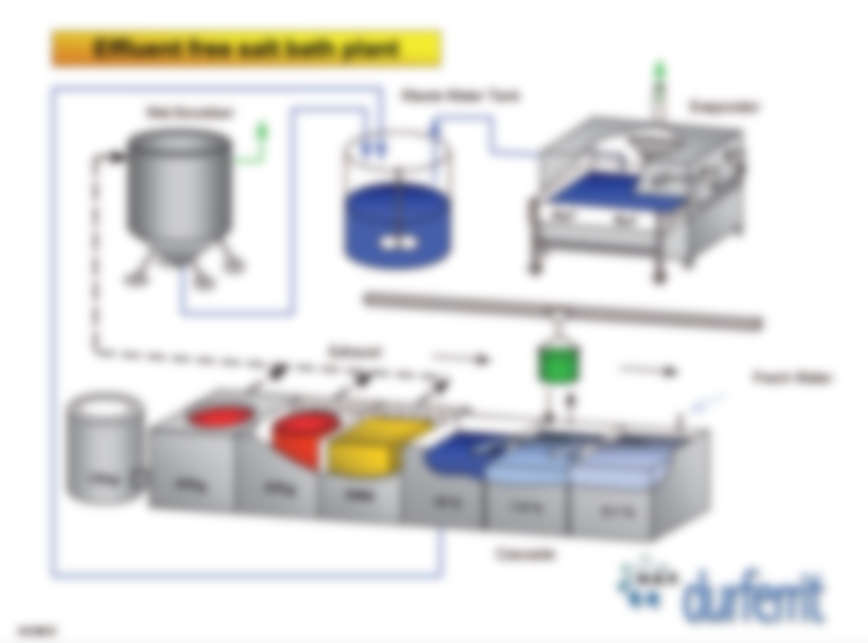
HEF Group – Salt Bath For Heat Treatment Business
Evaluation From The Market
Source: HEF Group Company Website

Slide 61
HEF Group – Salt Bath For Heat Treatment Business
Evaluation From The Market
TENIFER / TUFFTRIDE / MELONITE process
Product | Application | Working temp. in Celsius
XXX | XXX | XXX
XXX | XXX | XXX
XXX | XXX | XXX
XXX | XXX | XXX
XXX | XXX | XXX
XXX | XXX | XXX
XXX | XXX | XXX
XXX | XXX | XXX
XXX | XXX | XXX
DUROFER Process
Product | Application | Working temp. in Celsius
XXX | XXX | XXX
XXX | XXX | XXX
XXX | XXX | XXX
Source: Primary Interviews, Secondary Sources, HEF Group Company Website

Slide 62
HEF Group – Bushings/Joints Business
Key Customers | Typical Order Unit Price ($/unit) Average Weight: 2.5 kgs | Typical Order Quantity (kg/year)
XXX | XXX | XXX
XXX | XXX | XXX
XXX | XXX | XXX
XXX | XXX | XXX
XXX | XXX | XXX
Source: Primary Interviews
The weight of a bushing varies from 0.5 kgs to 5 kgs. The average weight of one bushing would be approximately 2.5 kgs.
Production Capacity and Factory Scale
XXX | XXX | XXX
 | XXX | XXX
 | XXX | XXX
 | XXX | XXX
Source: Primary Interviews
Note: The prices are may vary as they are dependent on several conditions such as furnace dimensions used, the maximum number of pieces that can be treated at one time, operational cost for a full load, the quantity or weight of a full load of treated components, etc. If less than a full load is treated, the total price based upon $/unit is compared with the minimum lot charge, and the greater of the two is applied.

Slide 63
HEF Group – Bushings/Joints Business
Technology Superiority
Bushings/Joints Business | Customer satisfaction with complaint handling (5-point rating) | Customers are satisfied with HEF’s complaint handling with a rating of 4-5. Customers mention that sometimes HEF’s complaint response process takes longer time than usual.
 | Satisfaction with the achievement of quality requirements (items for which specifications have been exchanged / items for which specifications have not been exchanged) | For the items for which specifications have not been exchanged, customers are very satisfied with the quality because HEF bushing are best quality in the industry and provide best results where extended intervals between lubrication applications are required. These bushing also stand out their competition in ability to withstand high loads, excellent frictional and anti-seizure properties. In case of items for which specifications have been exchanged as well HEF maintain its best in industry high quality. However, customers are not very satisfied with the high pricing in such cases.
 | Satisfaction with delivery schedule requirements | HEF Group offers timely delivery with occasional delays.
 | Satisfaction with the achievement of new development requirements (production engineering = efficiency improvement requirements/new processing development requirements) | Customers are highly satisfied with the achievement of new development requirements because HEF can design the hardened steel bushings according to customer demands with various kinds of internal grooves providing lubricant distribution and abrasive particles removing. The same patented technology can be used to manufacture flanged bushings or washers also. HEF Group is also capable of end-to-end production of all mechanical parts using HEF’s patented technologies.
Source: Primary Interviews
Surface Treatment Equipment Used For Bushings/Joints
Pot Type Furnace
Closed Chamber Furnace Cooling Units
Withdrawal Unit
Casting Equipment
Cutting Unit
Source: Primary Interviews

Slide 64
HEF Group – Bushings/Joints Business
HEF Groupe
Sales & Marketing
Operations – Customer Support
Finance
HR
Administration and Others
Locations
USA, Mexico, Canada
France, Czech Republic, UK, Poland, Germany, Spain, Italy, Hungary
Japan, India, China
Brazil
Source: HEF Groupe Company Website

Slide 65
HEF Group – Bushings/Joints Business
Evaluation From The Market
HEF group offers a wide variety of bushings under the categories such as steel bushings, composite bushings, slides, and frictional and mechanical compounds.
HEF bushings stands out from their other competition due to advantages such as ability to withstand high loads, excellent frictional and anti-seizure properties.
Additionally, HEF bushings are best in the industry for applications requiring extended intervals between lubrication.
The company’s engineered bushings have exceptional advantages in high-load and low rotational speed applications due to three main factors optimum steel selection and heat treatment, patented surface treatments, patented surface topographies, namely ID cross-hatching & surface cavities.
HEF also offers various patented bushing designs in different sizes and as well as in carburized and ground sleeve bearing types. The design for these bushings depends on the constraints of the work environment, including loading, abrasion, corrosion and maintenance requirement.
The selection of bushing for any application is mainly dependent on the pressure-velocity (PV) factor. Every HEF bushing design has its own unique PV curve which is necessary for determining the operating conditions and the appropriate bushing for a particular application.
Source: Primary Interviews, Secondary Sources, HEF Group Company Website

Slide 66
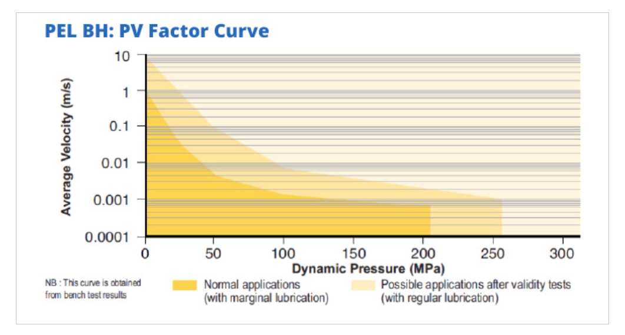
HEF Group – Bushings/Joints Business
Evaluation From The Market
Pressure-Velocity Curve For PEL BH Bushing
Source: HEF Group Company Website

Slide 67
HEF Group – Bushings/Joints Business
Evaluation From The Market
PEL Bushing by HEF combines a duplex surface treatment and a special surface topography which leads to excellent wear and seizure resistance.
Advantages of PEL bushings include interval of lubrication up to 250 hours, excellent resistance to seizure and wear, excellent distribution of the grease on the entire friction surface.
HEF Group has introduced new developments in PEL BH2 bushings which leads to improved wear resistance. This new technology is also available on spherical plain bearing in case of angular misalignment or flexion in the joint.
Comparison Of PEL BH Bushings
Product | Dyn. Load (N/mm²) | Max speed (m/s) | Max Temp (°C) | Abrasion resistance | Shock resistance | Corrosion resistance | Low-Maintenance
PEL BH | 200 | 1,5 | 250 | ++ | ++ | ++ | +++
PEL BH2 | 250 | 1,5 | 250 | +++ | ++ | ++ | +++
PEL BH3 | 250 | 1,5 | 250 | +++ | ++ | ++ | ++++
PEL BHR | 150 | 1,5 | 250 | ++ | ++ | ++ | +++
Source: Primary Interviews, Secondary Sources, HEF Group Company Website

Slide 68
HEF Group – Bushings/Joints Business
Evaluation From The Market
HEF’s hardened steel bushings are superior for use in low speed/ high load, or pivot applications. These are manufactured with high carbon steel and through-hardened to 56-62 HRC.
HEF can design the hardened steel bushings according to customer demands with various kinds of internal grooves providing lubricant distribution and abrasive particles removing.
Using this patented technology flanged bushings or washer could also be produced.
HEF polymer bushings have excellent advantages of self-lubrication and zero-maintenance properties. These have a unique woven structure made of PTFE and epoxy resin which leads to superior tensile strength as compared to injection molded polymer bushings.
HEF polymer bushing are also more resistance to seizure, high loads, and galling.
The company’s patented high load polymer bushings are chemically inert and have low water absorption with maximum working temperature of 160-degree Celsius.
HEF Group is also capable of end-to-end production of all mechanical parts using HEF’s patented technologies. This simplifies the entire logistic flow and use of intermediaries.
Source: Primary Interviews, Secondary Sources, HEF Group Company Website

Slide 69
HEF Group – Bath Salt For Heat Treatment Business
Key Customers | Typical Order Unit Price ($/kg) | Typical Order Quantity (kg/year)
General Motors | ~2 | ~18,000
Ford Motors | ~5 | ~16,000
ALPEN-MAYKESTAG GmbH | ~1.5 | ~14,000
Wegener Härtetechnik GmbH | ~3 | ~8,000
Bass GmbH & Co. KG | ~4 | ~7,000
Source: Primary Interviews
Regenerator salts are sold at 10-15% higher price as compared to base salt
Production Capacity and Factory Scale
Bath Salt For Heat Treatment Business | Production Capacity (kg/month) | ~85,000
 | Current Production operation hours per day | 7-8 hours
 | Number of employees | ~500
 | Production Land scale : m2 | ~155,000
Source: Primary Interviews

Slide 70
HEF Group – Bath Salt For Heat Treatment Business
Technology Superiority
Bath Salt For Heat Treatment Business | Customer satisfaction with complaint handling (5-point rating) | Customers are highly satisfied with HEF’s complaint handling with a rating of 5 while occasionally having complains with response delay.
 | Satisfaction with the achievement of quality requirements (items for which specifications have been exchanged / items for which specifications have not been exchanged) | Customers mention that HEF salts are of high quality and most of them are cyanide free making them an environment friendly option. Thus, they are satisfied with the achievement of quality requirements for items for which specifications have not been exchanged. Customers are satisfied with the achievement of quality requirements for items for which specifications have been exchanged. However, high pricing of such items remains an issue.
 | Satisfaction with delivery schedule requirements | Customers are extremely satisfied with HEF’s timely delivery, but they also mentioned there has been occasional delays.
 | Satisfaction with the achievement of new development requirements (production engineering = efficiency improvement requirements/new processing development requirements) | Customers mentioned that apart from base salts HEF also provide for some valuable additives which enhances the performance of the process. Customers are satisfied with the achievement of new development requirements and claim that HEF’s salts are of high quality.
Source: Primary Interviews

Slide 71
HEF Group – Bath Salt For Heat Treatment Business
HEF Groupe
Sales & Marketing
Operations – Customer Support
Finance
HR
Administration and Others
Locations
USA, Mexico, Canada
France, Czech Republic, UK, Austria, Poland, Germany, Spain, Switzerland, Italy, Hungary
Japan, India, China, Thailand, Malaysia, South Korea
Brazil
South Africa
Source: HEF Groupe Company Website

Slide 72
HEF Group – Bath Salt For Heat Treatment Business
Evaluation From The Market
HEF group offers salts for various process such as nitriding, nitrocarburizing, carburizing and carbonitriding, annealing and hardening, high speed salts for heat treatment, quenching and tempering, vulcanizing, aluminum heat treatment, blackening, and cleaning (can be optimized as per the application).
As per customers, HEF’s salts are of premium quality and most of the times offered along with the process they are used for.
HEF offers salts for nitriding and nitrocarburizing for the product range of Tenifer, Tuftride, Melonite, Arcor, NSK
Salts For Carburizing And Carbonitriding
These are offered for the Durofer process mainly.
These salts attribute advantages such as temperature uniformity, high reproducibility of the carburizing effect, and easy accessibility to the carburizing processes.
Durofer salts do not contain any cyanide and the carbon activity is controlled by adding the regenerator CECONTROL, thus generating considerably less waste salt and making the entire process very environment friendly.
Due to these advantages, the Durofer process can be used for hardening as it is free of decarburization if the melt is set for low activity.
Solid carburizing product granules have advantages such as consistent carburizing activity, low sulphur content, high stability, low tendency of forming dust during usage, capability of being used several times.
Source: Primary Interviews, Secondary Sources, HEF Group Company Website

Slide 73
HEF Group – Bath Salt For Heat Treatment Business
Evaluation From The Market
Annealing And Hardening Salts
Annealing salts are used in combination of an additive to prevent oxidation and decarburization of the treated components. The chance of oxidation and decarburization increases considerably as the treatment temperature rises.
HEF is offering two different categories of additives:
Cyanide free additives: These bind to the oxygen containing compounds and maintain the inertness of the liquid. These can be used up to a temperature of 1100 °C.
Carbon activity additives: These impart carbon activity on the salt melts depending upon the concentration and nature of base salt.
High Speed Salts
HEF’s high speed salts offer highest temperature uniformity and quickest heat transfer due to which a fine grain structure with the corresponding proportion of solute carbides is obtained.
The pre-eutectoid carbide precipitation at the grain boundaries or local formation of intermediate structure are prevented using these salts.
Customers claim that HEF salts provides benefits such as highest hardness combined with excellent toughness, ideal quenching conditions regardless of part diameter, partial hardening easy realizable, and lowest distortion compared to other hardening processes
Source: Primary Interviews, Secondary Sources, HEF Group Company Website

Slide 74
HEF Group – Bath Salt For Heat Treatment Business
Evaluation From The Market
Quenching And Tempering Salts
As per customers HEF’s AS salts are the best choice for quenching and tempering because they give the best attainable toughness.
HEF’s also provides special additives for water quenching with improved performances.
Vulcanizing Salts
Rubbercure salts are specially designed heat transfer salts which are mainly used for the vulcanization of rubber products which are continuously extruded. Advantages of rubbercure salts include high vulcanization speed, high long-term thermal stability of the salt melt, compact profile surface without any porosity, no notable corrosive attack through the salt melt, and these are easy to clean.
Aluminum Heat Treatment Salts
Aluminum heat treatment salts have excellent temperature constancy, and they provide quickest heat transfer by contact which successfully oppresses grain growth for gaining a very fine core structure, avoidance of deleterious precipitation of alloying elements on grain boundaries since the remaining salt film on the parts prevents from critical cooling effects during transfer into quenching station, and shortest treatment times
Source: Primary Interviews, Secondary Sources, HEF Group Company Website

Slide 75
HEF Group – Bath Salt For Heat Treatment Business
Evaluation From The Market
TENIFER / TUFFTRIDE / MELONITE process
Product | Application | Working temp. in Celsius
TF 1 | Cyanide-free replenishment nitriding salt. For use only with REG 1 regenerator. | 480-630
REG 1 | Regenerator for TF 1 Baths
AB 1 | Oxidizing salts for quenching TF 1 treated components and for carrying out QPQ process. It enhances the corrosion resistance. | 380-420
AB 1 A | Starter salts for initial filing
TF-N | Cyanide free replenishment salt. For use only with REG-N regenerator. | 480-630
REG-N | Regenerator for TF-N Baths
TF-LK | Additives for the base salt TF-N
AB-N R | Oxidizing salts for quenching TF-N treated components and for carrying out QPQ process. It enhances the corrosion resistance. | 420-440
AB-N | Starter salts for initial filing
ARCOR Process Salts
Product | Application | Working temp. in Celsius
CR 4 / CR 8 | Cyanide-free replenishment nitriding salt for the ARCOR C / V /N process; for use only with CR 2R and CR REG N regenerators. | 480 - 630
CR2R / CR REG N | Non-toxic regenerators for CR4 / CR 8 nitriding salts.
OXINIT 1.2 | Oxidizing salt for cooling parts treated with CR 4 or CR 8; leads to an important increase of the corrosion resistance.
Source: Primary Interviews, Secondary Sources, HEF Group Company Website

Slide 76
HEF Group – Bath Salt For Heat Treatment Business
Evaluation From The Market
NSK Salts
Product | Application
NSK | In special cases for the artificial activation of the nitriding bathes.
NSK - LC | Regenerator for TF 1 Baths
DUROFER Process Salts
Product | Application | Working temp. in Celsius
CECONTROL | Non-toxic regenerator. For use only with the base salts CECONTROL 50 H, 80 B and 110 B.
CECONTROL 50 H | Cyanide free start-up and replenishment salt used in special cases as low carburizing salt to achieve a surface carbon level of approx. 0.5 %. For use only with CECONTROL regenerator. | 780-950
CECONTROL 80 B CECONTROL 110 B | Cyanide free start-up and replenishment salt to achieve surface carbon level of 0.8 % resp. 1.1 %. For use only with CECONTROL regenerator. | 820-950
Source: Primary Interviews, Secondary Sources, HEF Group Company Website

Slide 77
HEF Group – Bath Salt For Heat Treatment Business
Evaluation From The Market
Other Salts For Carburizing And Carbonitriding
Product | Application | Working temp. in Celsius
CECONTROL 80 CECONTROL 110 | One salt system to achieve a surface carbon level of approx. 0.8% C resp. 1.1% C | 850-950
CECONTROL 80A CECONTROL 110A | Starter salts for the initial filling
GS 540/C3 | This two-salt system is also suitable for carbonitriding below A1 | 700-950
HEF Group’s Solid Carburizing Products
Product | Application | Working temp. in Celsius
KG 6.2 | Mild carburizing granules for carburizing alloyed steels to depths over 0.6 mm. | ~900
KG 30.2 | Strong carburizing granules for carburizing non-alloyed and alloyed steels with depths up to approx. 0.6 mm. | ~900
Source: Primary Interviews, Secondary Sources, HEF Group Company Website

Slide 78
HEF Group – Bath Salt For Heat Treatment Business
Evaluation From The Market
HEF Group’s Base Salt For Annealing
Product | Application | Working temp. in Celsius
GS 230 | For quenching and tempering above 300°C | 270-600
GS 430 | For tempering, heating and quenching of steel for which AS bathes are not suitable. | 500-700
GS 520 | Replenisher salt for GS 430 baths.
GS 540 | For heating and annealing. | 600-950
GS 560 | For barium free salt for annealing of silver, gold and brass. | 600-850
GS 660 | Nontoxic (barium free) salt for annealing steel and non-ferrous metals. | 700-900
GS 670 | For heating and annealing. | 750-1000
GS 750 | For heating and annealing. | 850-1100
GS 960 | For heating and annealing. | 1050-1250
Source: Primary Interviews, Secondary Sources, HEF Group Company Website

Slide 79
HEF Group – Bath Salt For Heat Treatment Business
Evaluation From The Market
HEF Group’s Additive Salts For Inert Annealing (Cyanide-free)
Product | Application
R 2 | For quenching and tempering above 300°C.
R 3 | For tempering, heating and quenching of steel for which AS bathes are not suitable.
HEF Group’s Additive Salts For Preventing Decarburization
Product | Application
C 1 | For the prevention of decarburization and oxidation in combination with GS 540, GS 560, GS 660, GS 670, if the carbon content of C 3 is undesirable.
C 3 | For the prevention of decarburization and oxidation in combination with GS 540, GS 560, GS 660, GS 670. Contains active carbon to form a bath cover.
Source: Primary Interviews, Secondary Sources, HEF Group Company Website

Slide 80
HEF Group – Bath Salt For Heat Treatment Business
Evaluation From The Market
HEF Group’s Salts For Heat Treatment Of High-speed Steels
Product | Application | Working temp. in Celsius
GS 540 | Salt for the 2nd preheating stage | 800-900
GS750/R2 | 2-salt systems for the 3rd preheating stage | 1050-1100
CARBONEUTRAL | For austenitizing of high alloyed tool and high-speed steels. Additives are reducing decarburization. | 1000-1300
SEMPERNEUTRAL 950 | For austenitizing of high alloyed tools and high-speed steels. Additives prevent from decarburization. | 1100-1300
SEMPERNEUTRAL 1100 | For austenitizing of high-speed steels. Additives prevent from decarburization. Less sensitive to moisture. | 1200-1300
GS 430 | Quenching salt for high alloyed tool and high-speed steels. | 500-580
Supplements
DUROPERL | For covering the CARBONEUTRAL or SEMPERNEUTRAL baths. | 750-1000
SILIRON HS | Additive to accelerate the subsequent aqueous cleaning. | 850-1100
GS 960 | For saturating a new lining of the furnace. | 1050-1250
Source: Primary Interviews, Secondary Sources, HEF Group Company Website

Slide 81
HEF Group – Bath Salt For Heat Treatment Business
Evaluation From The Market
HEF Group’s Salts For Quenching And Tempering
Product | Application | Working temp. in Celsius
AS 140 | For austempering, martempering, tempering and blueing. Not suitable for components which are heated above 950 °C or treated in a bath containing more than 13 % KCN. | 160-550
AS 220 | For austempering, martempering, tempering and blueing. Not suitable for components which are heated above 950 °C or treated in a bath containing more than 13 % KCN. | 250-550
AS 235 | Nontoxic salt for austempering, martempering, tempering and blueing. Not suitable for components which are heated above 950 °C or treated in a bath containing more than 13 % KCN. | 280-550
AS 300 | Nontoxic salt for austempering, tempering and blueing. Not suitable for components which are heated above 950 °C or treated in a bath containing more than 13 % KCN. | 340-550
GS 230 | For quenching and tempering above 300 °C. | 270-600
GS 430 | For quenching and tempering parts which are austenitized at temperatures above 950 °C. | 500-700
Source: Primary Interviews, Secondary Sources, HEF Group Company Website

Slide 82
HEF Group – Bath Salt For Heat Treatment Business
Evaluation From The Market
HEF Group’s Salts For Vulcanizing
Product | Application | Working temp. in Celsius
RUBBERCURE | For vulcanizing in LCM and PLCV plants. | >180
RUBBERCURE LAS | Nontoxic classified vulcanizing salt. | >160
HEF Group’s Salts For Aluminum Heat Treatment
Product | Application | Working temp. in Celsius
AVS 220 | For solution annealing and age hardening of aluminum and aluminum alloys containing maximal 10% of magnesium. | 270 – 550
AVS 250 | For solution annealing and age hardening of aluminum and aluminum alloys containing maximal 10% of magnesium. | 340 – 550
Source: Primary Interviews, Secondary Sources, HEF Group Company Website

Slide 83
HEF Group – Bath Salt For Heat Treatment Business
Evaluation From The Market
HEF Group’s Salts For Blackening
Product | Application | Working temp. in Celsius
G19 / G22 | Alkaline cleaner for hot degreasing prior to blackening | 60 - 80
BEIZENTFETTER | For descaling prior to blackening. Has some degreasing properties.
FERROBLACK MH | Blackening salt containing special additives for a wide range of application. | 140 approx.
FERROBLACK SPEZIAL | Ideal for blackening silicon steels and cast iron. | 140 approx.
FERROBLACK HL | Particularly suitable for parts with copper coatings and brazed joints | 140 approx.
FERROBLACK NIF | Non-toxic blackening salt; more suitable for 2-bath processes. | 140 approx.
FERROSOL HL | A booster for all blackening bathes either for short-term regeneration or for treatment of complicated workpieces.
STREICH-BRÜNIERBEIZE | A fluid product for brushing on or immersion at room temperature. Ideal for repairs and hobby use.
DRS 3 | Emulsion for dipping to improve corrosion resistance.
Source: Primary Interviews, Secondary Sources, HEF Group Company Website

Slide 84
HEF Group – Bath Salt For Heat Treatment Business
Evaluation From The Market
HEF Group’s Salts For Heat Transfer
Product | Application | Working temp. in Celsius
ASD | Heat transfer salt for the chemical industry | 180-450
ASD REG | For regenerating ASD salts
HT 400 | Heat transfer salt for the chemical industry for use at higher temperatures | >400
HEF Group’s Cleaning Salts
Product | Application | Working temp. in Celsius
ALKO N | For descaling titanium. | 200 – 220
KOLENE No.4 | Removes molding sand, graphite, oil coke, casting crust and scale. For cast iron, steel and cast aluminum. | 400 – 500
KOLENE No.5 | Removes organic materials: semi and fully synthetic plastics, paint, lacquer, grease, oil, resin, carbon, graphite, rubber etc. Some strongly reactive plastics. Ideal for cleaning steel and cast iron. | 400 – 500
KOLENE No.6 | Removes paint, oil carbon and plastics from aluminum and steel work pieces, also grey cast iron. | 300 – 400
KOLENE No.10 | Removes organic materials: semi and fully synthetic plastics, paint, lacquer, grease, oil, resin, carbon, graphite, rubber etc. Ideal for cleaning chrome-alloyed tools. | 380 – 480
KOLENE DGS | Removes scale and rolling skin; metal oxides, glass residue (drawing agent), sand residue, oil coke, oil, grease and other organic traces from stainless steels and other Cr/ Ni materials. | 370 – 540
KOLENE RS 700 | Removes ceramic molding material based on silicon and aluminum oxides, also zirconium oxide, from precision castings. Devitrifies Pt Rh spinning nozzles and similar components, removes enamel | 600 – 700
Source: Primary Interviews, Secondary Sources, HEF Group Company Website

Slide 85

Conclusions

Slide 86
HEF Group – Technical Superiority
Business Segment | Technical Superiority
Nitriding | MELONITE & ARCOR series of HEF nitriding are the best in quality in the whole industry. These process also comply by industry standards SAE/AMS 2753 which are specified for critical components. HEF provides customizable post-nitriding impregnation depending upon customers' requirements.
Vacuum Deposition (PVD/PAVCD) | HEF has its patented coating technologies for vacuum deposition which help achieve unique coatings with best qualities. These technologies are Plasma Enhanced Magnetron Sputtering (PEMS), Coating Assisted by Microwaves (CAM), Modified ARC (M-ARC). PEMS technology provides various high-performance coatings which have customized hardness, density, and toughness. CAM coating technology allows deposition of hard and ultra-low friction coatings at very low temperature. It also has the ability to coat at low-pressure. The M-ARC method significantly reduces droplets formation which is normally associated with arc-deposited coatings.
Salt Bath For Heat Treatment | HEF designs customized systems for salt baths to meet various customers’ exact requirements. The company also offers its enormous amount of know-how as market leader. It assists with post treatment technical help.
Bushings/Joints | HEF bushing are best quality in the industry and provide best results where extended intervals between lubrication applications are required. These bushing also stand out their competition in ability to withstand high loads, excellent frictional and anti-seizure properties. HEF can design the hardened steel bushings according to customer demands with various kinds of internal grooves providing lubricant distribution and abrasive particles removing. The same patented technology can be used to manufacture flanged bushings or washers also. HEF Group is also capable of end-to-end production of all mechanical parts using its patented technologies.
Source: Primary Interviews, Secondary Sources, HEF Group Company Website

Slide 87
HEF Group – Technical Superiority
Business Segment | Technical Superiority
Bath Salts For Heat Treatment | As per customers, HEF’s salts are of premium quality and most of the times offered along with the process they are used for. Durofer salts do not contain any cyanide and the carbon activity is controlled by adding the regenerator CECONTROL, thus generating considerably less waste salt and making the entire process very environment friendly. As per customers HEF’s AS salts are the best choice for quenching and tempering because they give the best attainable toughness. Customers claim that HEF salts provides benefits such as highest hardness combined with excellent toughness, ideal quenching conditions regardless of part diameter, partial hardening easy realizable, and lowest distortion compared to other hardening processes Rubbercure salts are specially designed heat transfer salts which are mainly used for the vulcanization of rubber products which are continuously extruded.
Source: Primary Interviews, Secondary Sources, HEF Group Company Website

Slide 88
Global Market Share (%) – HEF Group
Global Market - HEF Group
Treatments/Salts | 2020 |  | 2025F
 | Market Share (%) | Market Size (USD Million) | Market Share (%) | Market Size (USD Million)
Nitriding | 5.0% | 154.7 | 6.7% | 242.9
Salt Bath For Heat Treatment | 4.0% | 49.5 | 4.5% | 69.7
Vacuum Deposition | 2.0% | 134.8 | 2.6% | 207.3
Bushings/Joints | 3.0% | 31.5 | 3.1% | 46.2
Total Sales | 370.6 | 370.6 | 566.2 | 566.2
Bath Salts For Heat Treatment – Total | 3.5% | 32.2 | 4.7% | 51.0
Nitriding Bath Salts For Heat Treatment | 4.1% | 11.4 | 4.9% | 18.4
Other Bath Salts For Heat Treatment | 3.2% | 20.9 | 1.7% | 11.8
Total Sales – HEF Group (including salt sales) | 402.8 | 370.6 | 617.1 | 566.2
Source: Primary Interviews, TechSci Research Estimates
HEF Group generated a sales of USD 402 Million from nitriding, vacuum deposition, salt bath for heat treatment, bushings, and bath salts for heat treatment business segments in 2020. The sales is projected to reach up to USD 617 Million.
In 2020, HEF Group has a market share of 5.0% with a market size of USD 154.7 Million in the Nitriding business. The market size is expected to reach USD 242.9 Million by 2025 having a market share of 6.7%.
The company generated sales of USD 49.5 Million from the salt bath for heat treatment segment having a market share of 4.0% in 2020. HEF Group is expected to generate annual sales of USD 60.7 Million by 2025 in the same segment, making the market share 4.5%.
As of 2020, the vacuum deposition segment has a market share of 2.0% with sales around USD 134.8 Million. The market share is expected to increase up to 2.6% with projected sales around USD 207.3 Million.
HEF Group has a market share of 3.0% in the bushing/joints business segment with sales of around USD 31.5 Million. The sales is projected to increase up to 46.2 USD Million with a market share of 3.1% by 2025.
The company generated sales of USD 32.2 Million from the bath salt for heat treatment segment having a market share of 3.5% in 2020. HEF Group is expected to generate annual sales of USD 51.0 Million by 2025 in the same segment, making the market share 4.7%.

Slide 89
Regional Market Share (%) – HEF Group, 2020
Regional Market Share - HEF Group, 2020
Treatments | North America | Asia - Total | Europe | Asia except India & China | South America | China | India | Others
Nitriding | 5.2% | 5.0% | 6.1% | 6.6% | 3.4% | 2.7% | 2.2% | 4.4%
Salt Bath For Heat Treatment | 4.7% | 4.5% | 4.0% | 6.8% | 2.4% | 1.7% | 1.1% | 2.7%
Vacuum Deposition | 2.0% | 1.9% | 1.9% | 2.1% | 1.8% | 1.4% | 1.3% | 5.3%
Bushings/Joints | 2.9% | 3.1% | 2.8% | 4.0% | 3.5% | 1.5% | 1.3% | 4.6%
Nitriding Bath Salts For Heat Treatment | 3.9% | 3.9% | 4.5% | 4.2% | 5.4% | 3.4% | 3.2% | 2.8%
Other Bath Salts For Heat Treatment | 1.7% | 1.8% | 1.9% | 1.9% | 2.7% | 1.7% | 1.6% | 0.8%
Source: Primary Interviews, TechSci Research Estimates
 | Highest
 | Second Highest
Regional Market Size - HEF Group, 2020
Treatments | North America | Asia - Total | Europe | Asia except India & China | South America | China | India | Others
Nitriding | 57.6 | 38.4 | 34.0 | 30.7 | 13.8 | 4.6 | 3.1 | 11.0
Salt Bath For Heat Treatment | 19.3 | 12.9 | 9.9 | 11.1 | 3.9 | 1.1 | 0.6 | 3.5
Vacuum Deposition | 49.3 | 32.4 | 29.3 | 24.2 | 14.6 | 5.0 | 3.2 | 9.3
Bushings/Joints | 12.2 | 7.9 | 7.3 | 6.7 | 3.6 | 0.7 | 0.4 | 0.6
Nitriding Bath Salts For Heat Treatment | 4.1 | 2.8 | 2.5 | 1.9 | 1.4 | 0.5 | 0.3 | 0.6
Other Bath Salts For Heat Treatment | 4.3 | 2.7 | 2.4 | 1.9 | 1.5 | 0.4 | 0.3 | 0.5
Source: Primary Interviews, TechSci Research Estimates
North America is the largest region for HEF Group’s all five business segments. In 2020, HEF Group’s regional market for North America was USD 57.6 Million, USD 19.3 Million, USD 49.3 Million, USD 12.2 Million, USD 4.1 Million, and USD 4.3 Million for nitriding, salt bath for heat treatment, vacuum deposition, bushings/joints, nitriding bath salts for heat treatment, other bath salts for heat treatment, respectively.
The North America market is followed by Europe market with size of USD 34 Million, USD 9.9 Million, USD 29.3 Million, USD 7.3 Million, USD 2.8 Million, and USD 4.3 Million for nitriding, salt bath for heat treatment, vacuum deposition, bushings/joints, nitriding bath salts for heat treatment, other bath salts for heat treatment, respectively.

Slide 90
Regional Market Share (%) – HEF Group, 2025
Regional Market Share - HEF Group, 2025
Treatments | North America | Asia - Total | Europe | Asia except India & China | South America | China | India | Others
Nitriding | 6.9% | 6.7% | 8.2% | 9.1% | 4.7% | 3.9% | 3.2% | 5.4%
Salt Bath For Heat Treatment | 5.0% | 5.0% | 4.6% | 7.6% | 3.0% | 2.0% | 1.5% | 2.2%
Vacuum Deposition | 2.8% | 2.5% | 2.6% | 2.8% | 1.7% | 2.0% | 1.9% | 4.1%
Bushings/Joints | 3.2% | 3.3% | 2.9% | 4.2% | 2.1% | 1.7% | 1.6% | 5.0%
Nitriding Bath Salts For Heat Treatment | 5.3% | 4.6% | 5.3% | 5.1% | 4.2% | 4.0% | 3.8% | 2.9%
Other Bath Salts For Heat Treatment | 2.9% | 2.7% | 2.8% | 2.8% | 2.7% | 2.4% | 2.3% | 0.8%
Source: Primary Interviews, TechSci Research Estimates
 | Highest
 | Second Highest
Regional Market Size - HEF Group, 2025
Treatments | North America | Asia - Total | Europe | Asia except India & China | South America | China | India | Others
Nitriding | 92.8 | 62.9 | 55.1 | 48.4 | 22.8 | 8.7 | 5.9 | 9.2
Salt Bath For Heat Treatment | 27.7 | 18.9 | 14.6 | 15.9 | 5.9 | 1.8 | 1.1 | 2.7
Vacuum Deposition | 84.4 | 53.1 | 46.9 | 38.5 | 15.3 | 8.8 | 5.8 | 7.7
Bushings/Joints | 19.6 | 12.1 | 10.9 | 10.1 | 2.9 | 1.2 | 0.8 | 0.8
Nitriding Bath Salts For Heat Treatment | 7.4 | 4.7 | 4.2 | 3.2 | 1.5 | 0.9 | 0.6 | 0.6
Other Bath Salts For Heat Treatment | 7.6 | 4.6 | 4.0 | 3.2 | 1.6 | 0.8 | 0.6 | 0.6
Source: Primary Interviews, TechSci Research Estimates
In the forecast period as well, North America is the largest region for HEF Group’s all four business segments. In 2025, HEF Group’s regional market for North America is expected to reach USD 92.8 Million, USD 27.7 Million, USD 84.4 Million, USD 19.6 Million, USD 7.4 Million and USD 7.6 Million for nitriding, salt bath for heat treatment, vacuum deposition, bushings/joints, nitriding bath salts for heat treatment, other bath salts for heat treatment, respectively.
The North America market is followed by Europe market with size of USD 55.1 Million, USD 14.6 Million, USD 46.9 Million, USD 10.9 Million, USD 4.7 Million, and USD 4.6 Million for nitriding, salt bath for heat treatment, vacuum deposition, bushings/joints, nitriding bath salts for heat treatment, other bath salts for heat treatment, respectively.

Slide 91


Thank you!!
We look forward to serving your research needs!!
TechSci Research – North America
708 Third Avenue, Manhattan,
New York, United States
Tel: +1- 646- 360- 1656
Email: sales@techsciresearch.com www.techsciresearch.com
TechSci Research – Asia-Pacific
B – 44, Sector – 57, Noida, National Capital Region, U.P. - India
Tel: +91-120-4523900
Email: sales@techsciresearch.com www.techsciresearch.com
TechSci Research – Europe
54, Oldbrook, Bretton,
Peterborough,
United Kingdom
Email: sales@techsciresearch.com www.techsciresearch.com

